Slide 1
Predicting House Prices with Gradient Boosting, Spectral Clustering, and Principal Components Analysis
Author: Neil Kutty
for : Machine Learning - GWU
Instructor: Dr. Richard Xie

Slide 2
Introduction
The data for this project has 79 native features and an outcome variable for the dollar($) amount a house sold for. Prior research (see: De Cock, Dean, Journal of Statistics Education Volume 19, Number 3(2011) https://ww2.amstat.org/publications/jse/v19n3/decock.pdf) conducted on this dataset has shown low accuracy ~70% for OLS Linear models. We seek to improve on this prior research by using Gradient Boosting, Spectral Clustering for feature derivation, and Principal Component Analysis for feature selection.
The features are a mix of categorical and continuous variables.
Around 7000 values are NA out of a total of approximately 111,300 values.
We forego utilizing dummy variables for this iteration in order to perfectly match the test set’s feature count.
Our best model is through gradient boosting with 250 estimators resulting in a 91.67\% accuracy rate when using the top 75 features including derived features obtained through unsupervised learning and then ranked by PCA.

Slide 3
Data Description
Source: https://ww2.amstat.org/publications/jse/v19n3/decock/DataDocumentation.txt
NAME: AmesHousing.txt TYPE: Population SIZE: 2930 observations, 82 variables ARTICLE TITLE: Ames Iowa: Alternative to the Boston Housing Data Set DESCRIPTIVE ABSTRACT: Data set contains information from the Ames Assessor’s Office used in computing assessed values for individual residential properties sold in Ames, IA from 2006 to 2010. SOURCES: Ames, Iowa Assessor’s Office VARIABLE DESCRIPTIONS: Tab characters are used to separate variables in the data file. The data has 82 columns which include 23 nominal, 23 ordinal, 14 discrete, and 20 continuous variables (and 2 additional observation identifiers).

Slide 4
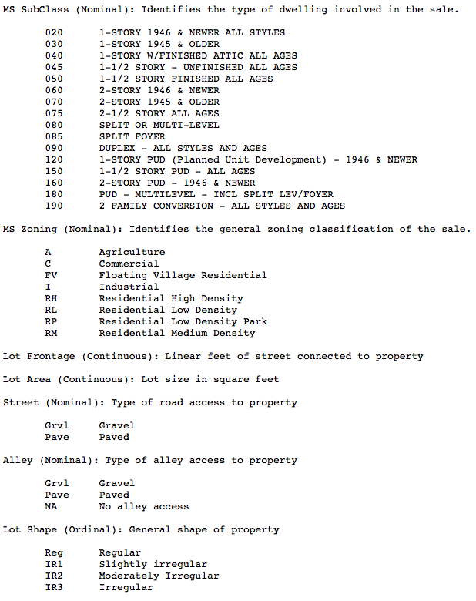
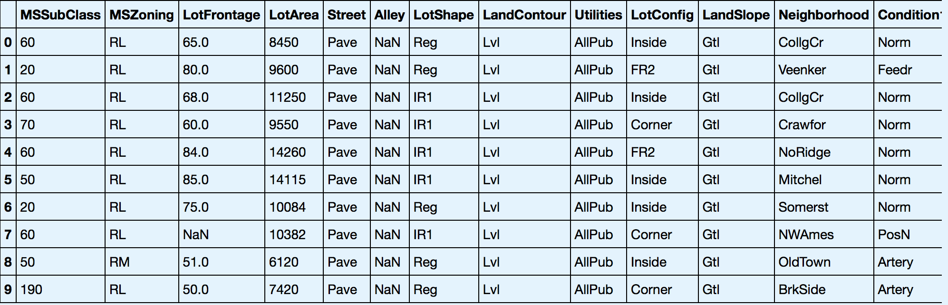
Exploring the Dataset
The dataset has a mix of continuous/discrete and categorical variables.
For expediency we fill NA values with zero as this addresses both the categorical and numerical missing-value identification for modeling.
In order to enumerate the entire dataset, we pre-process by separating the numeric and non-numeric columns, retrieve and assign the category codes for the non-numeric columns back to them, and then re-join the full dataset.

Slide 5
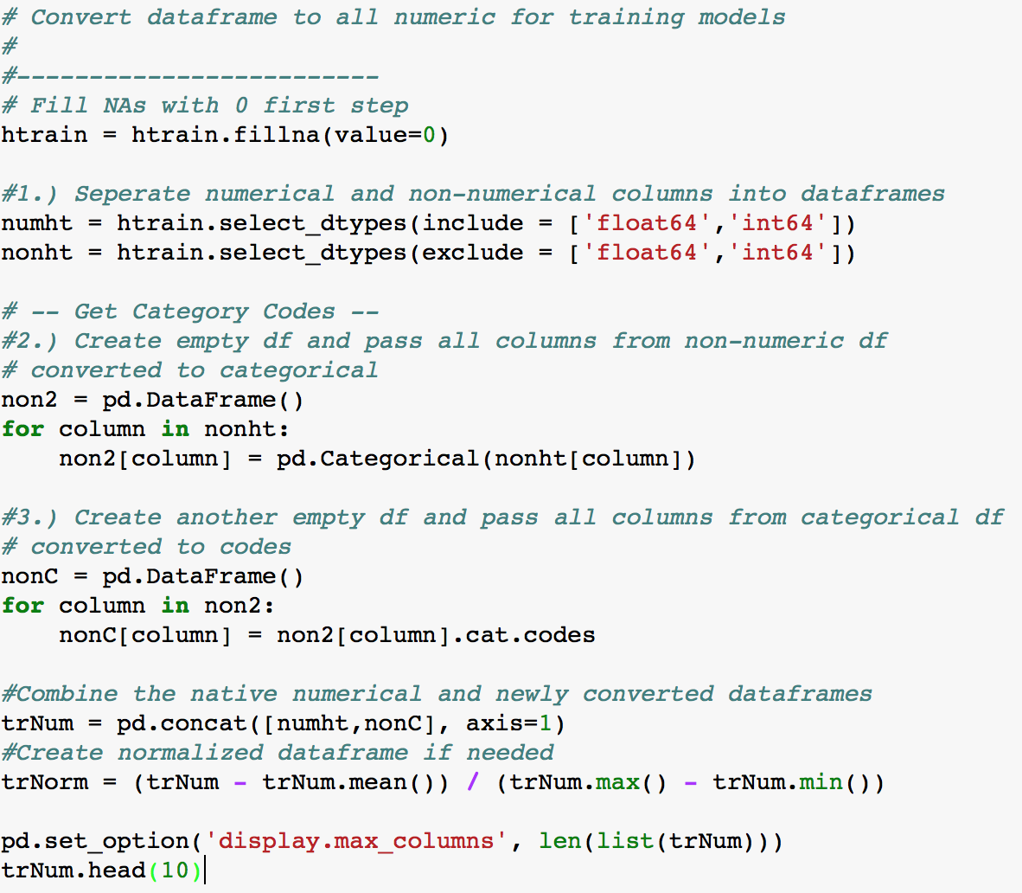
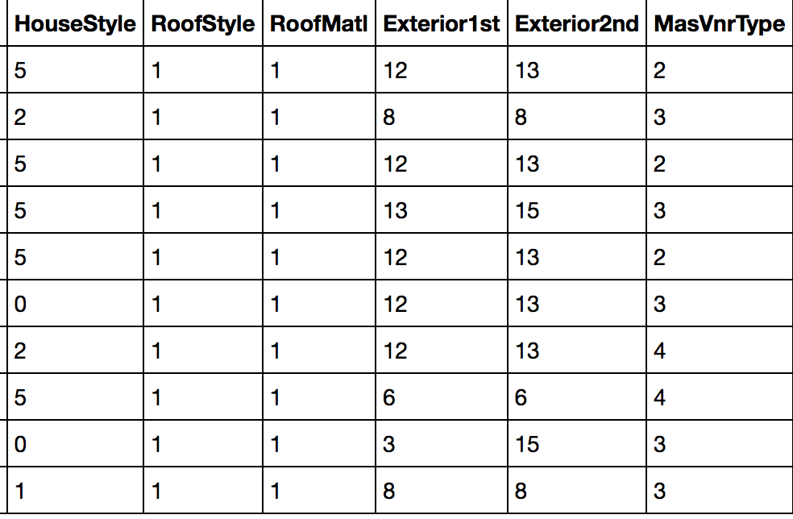
Data Cleaning
To simplify the data cleaning efforts, we separate the numerical columns from the non-numeric and then convert the non-numeric columns to category codes before rejoining the dataset as one.

Slide 6
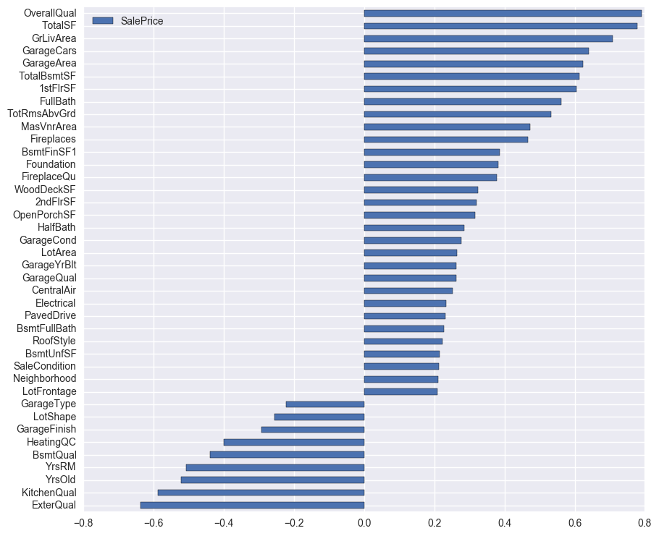
Data Exploration
Correlations of Variables to Sale Price where corr > 0.2
Here, we look at correlations of all predictors to the outcome var where that correlation > 0.2.
As expected, the size of the house (GrLivArea, TotalSF) is highly correlated to Sale Price. Similarily, a higher Overall Quality ranking is highly correlated to an expected higher Sales Price.
Our strongest negatively correlated variables are related to the age of the property, along with Quality measures where the value scale is inverted.

Slide 7
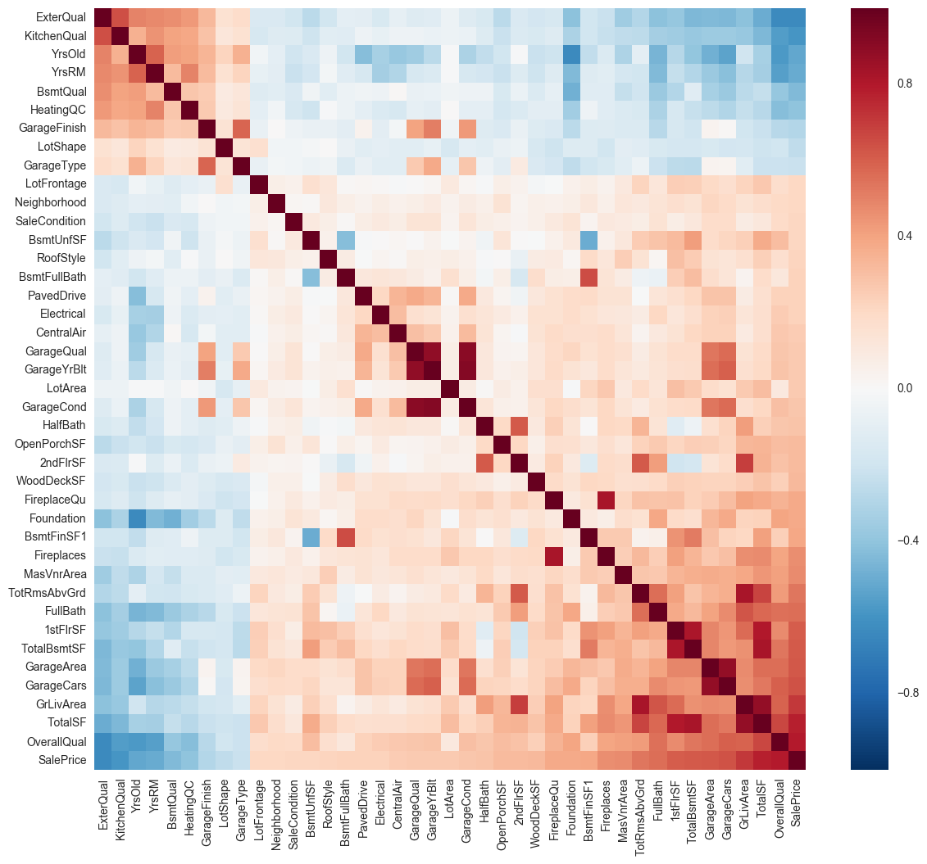
Data Exploration
Correlations of Variables to to each other where correlation to Sale Price > 0.2
As expected, we see strong collinearity across variables concerned with a top-level attribute of the property (i.e. Garage vars, Basement vars).
There is also a healthy lack of multicollinearity across many of the features.
For future iterations of this project, it would be worthwhile to explore engineering core derived features for these top-level attributes that combine these native features.

Slide 8
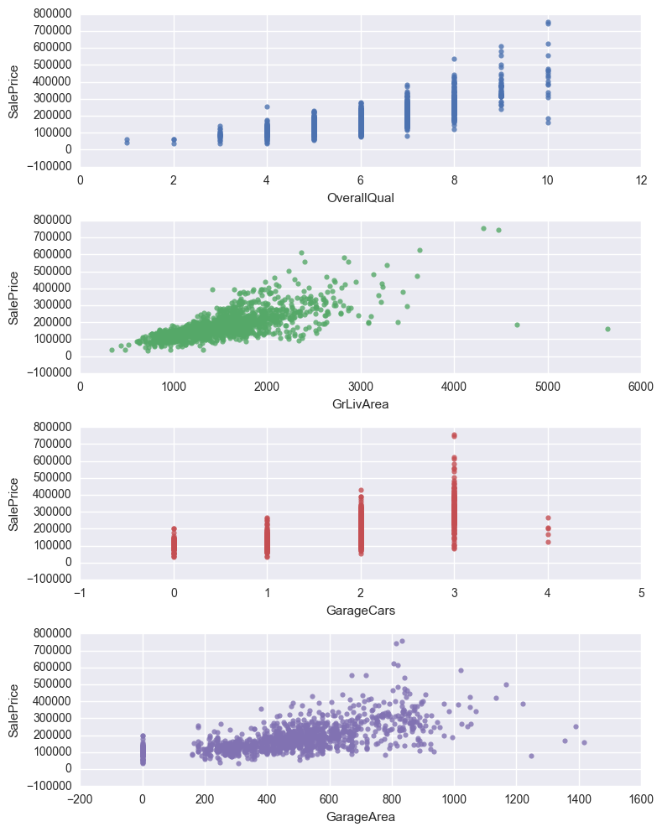
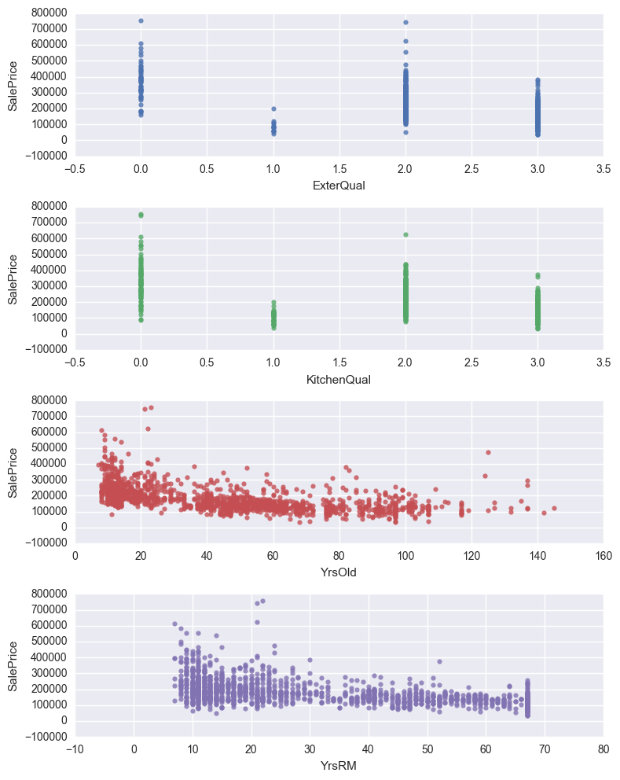
Top Outcome-Correlated Variables Visualized

Slide 9
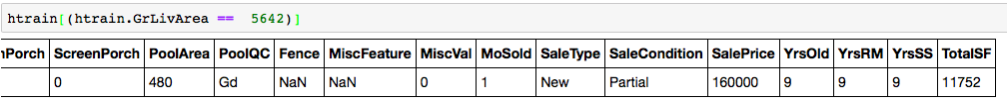
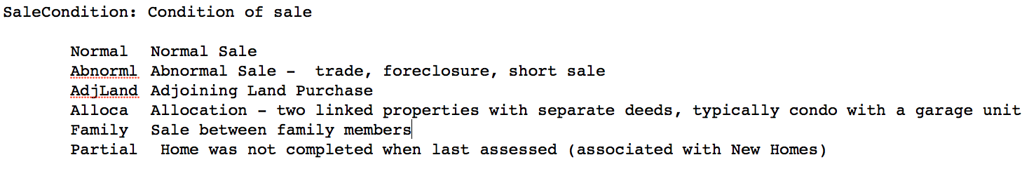
Outliers
Some outliers, like the one below, have a low price for “higher-price” oriented features seemingly captured exclusively in the SaleCondition predictor variable.
However, the identifiers for a house like below (‘Partial’) may be associated with higher variability in associated outcome value, thus simply relying on this variable for an accurate quantitative outcome may not be fruitful.

Slide 10
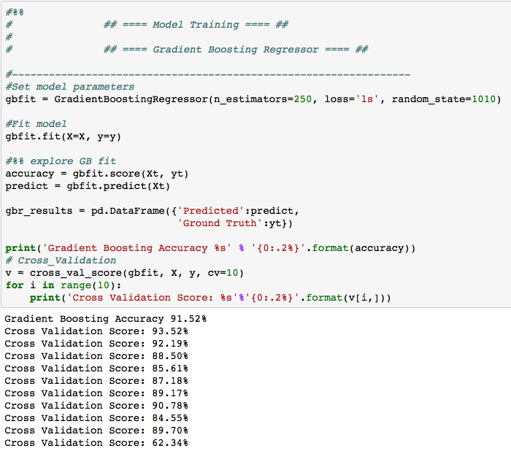
Model Training
We train a Gradient Boosting Regressor initially for the feature_importances_ attribute.
Our out-of-sample error expectation is highly variable from the cross-validation scores shown. Therefore, we can’t conclude a lot of confidence in our accuracy score of 91.52% for the initial regression with all variables.

Slide 11
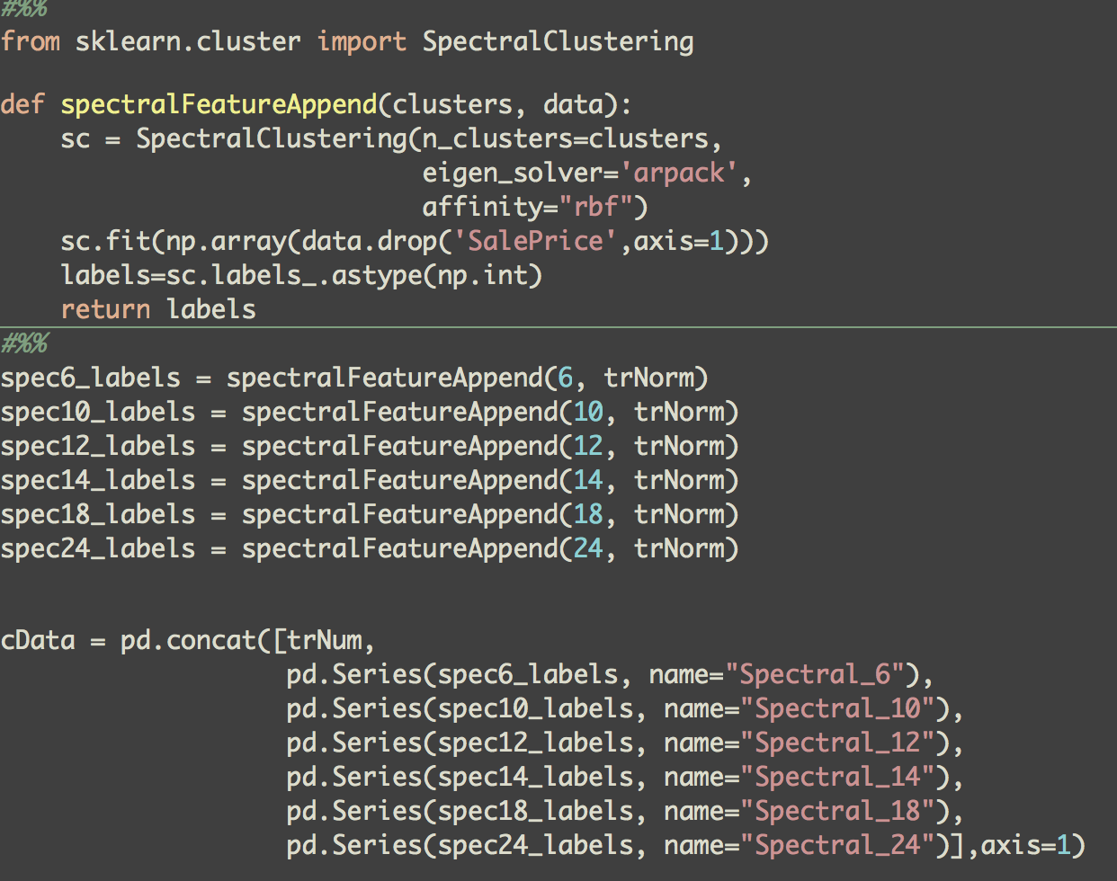
Unsupervised Learning: Spectral Clustering
We define a function below to fit a Spectral Clustering model on the predictors for a given number of n\_clusters and return the resulting cluster labels.
The determined cluster assignment of each record, for the given clustering fit, is then added to the dataset as a new feature. We perform this feature derivation for six different iterations of cluster numbers (6, 10, 12, 14, 18, \& 24).

Slide 12
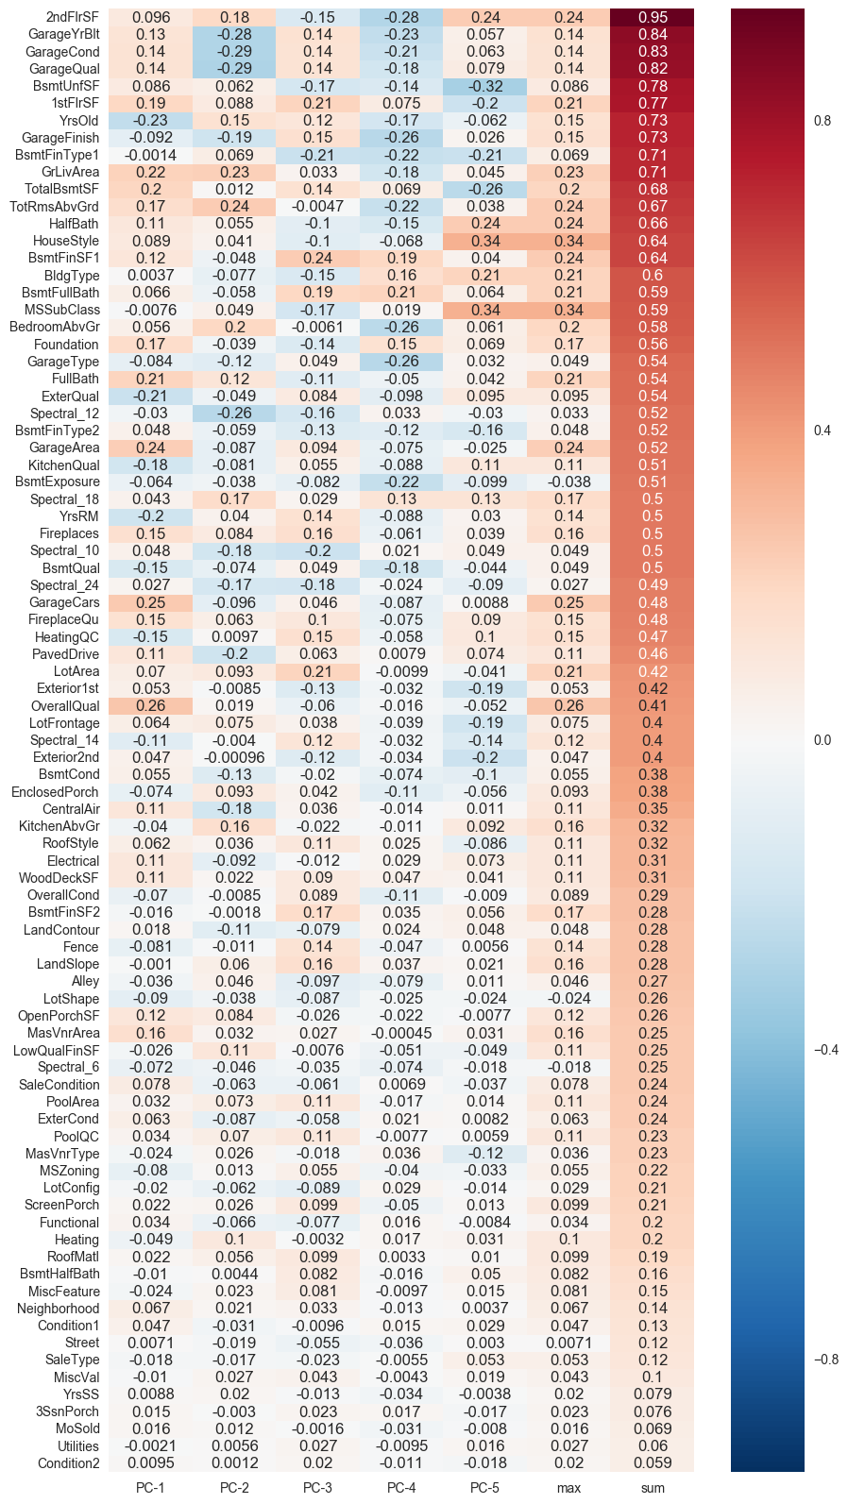
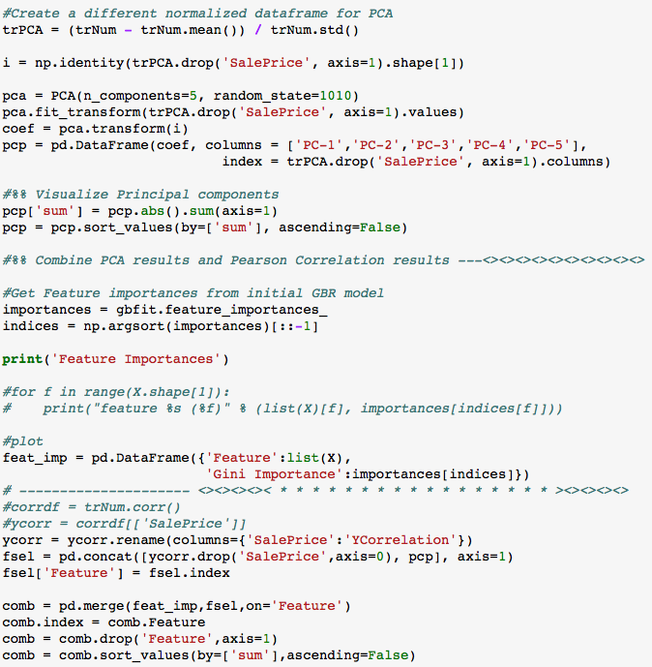
Principal Component Analysis
Taking absolute value sum of eigenvalues for each feature across the 5 Components.

Slide 13
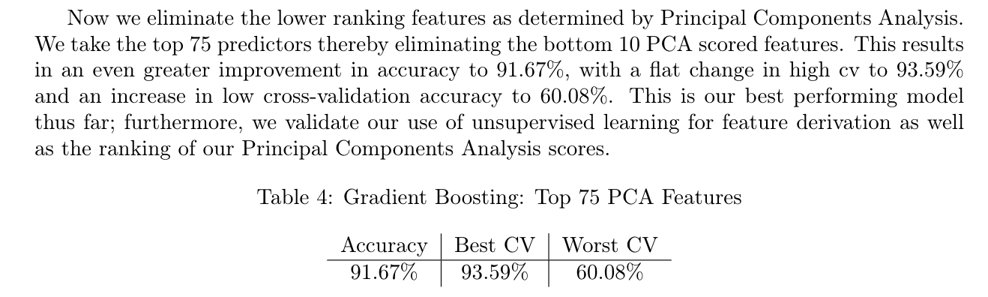
Model Training accounting for top 75 PCA ranked features
Here we account for the top PCA derived components. We rank them as the absolute value sum of the eigenvalues for each component across a single feature.
We train the same Gradient Boosting Regressor this time on a training set of only the top 75 predictors.
Our scores are very similar to the initial regression we performed above; however, with slightly higher accuracy and slightly higher out-of-sample accuracy.
This iteration turns out to be our best performance.

Slide 14
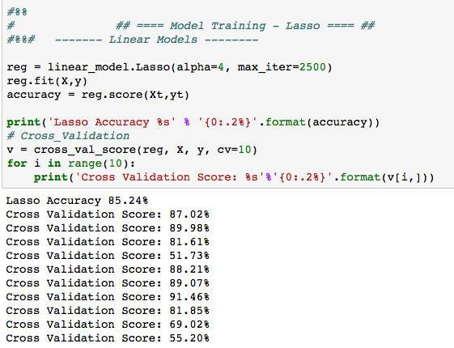
Model Training - Lasso
Our Lasso score is even lower with not only greater variability in out-of-sample error, but also a much lower initial accuracy.

Slide 15
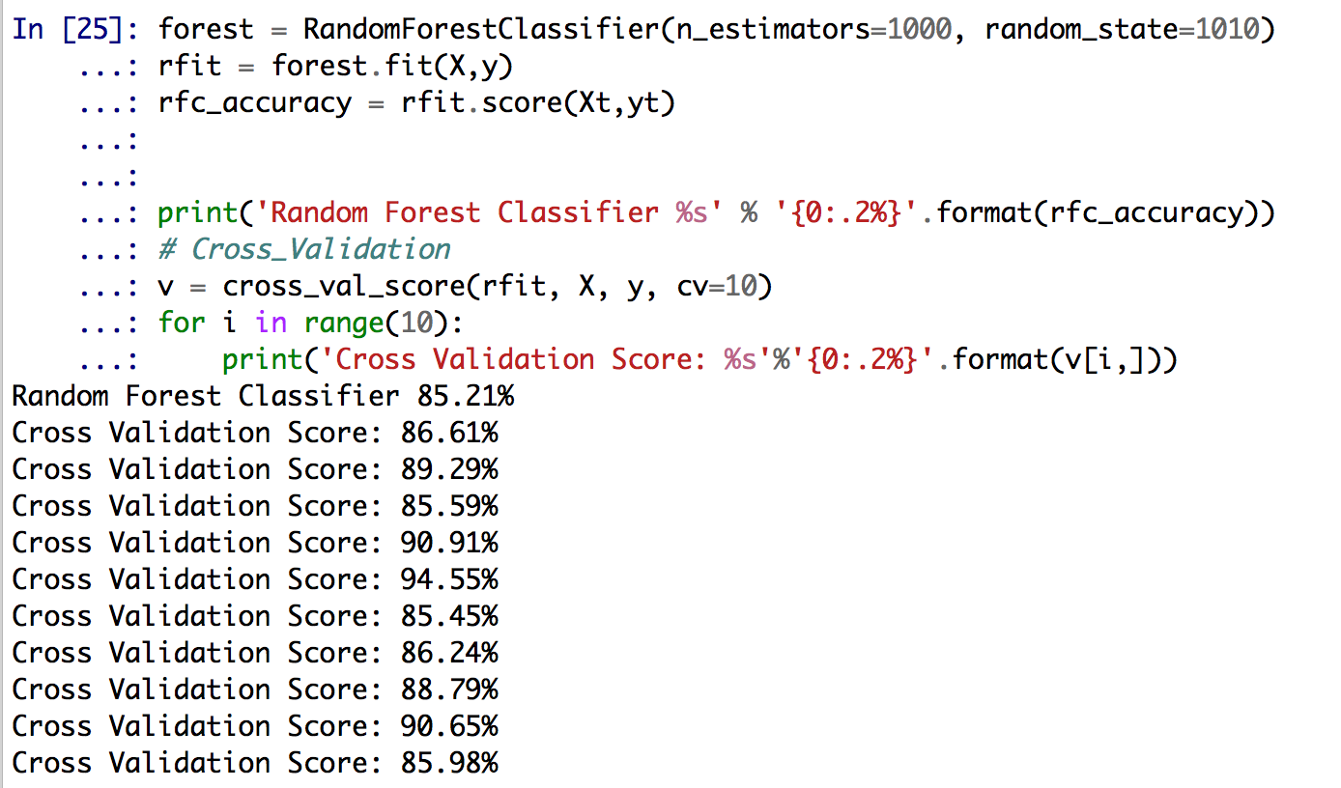
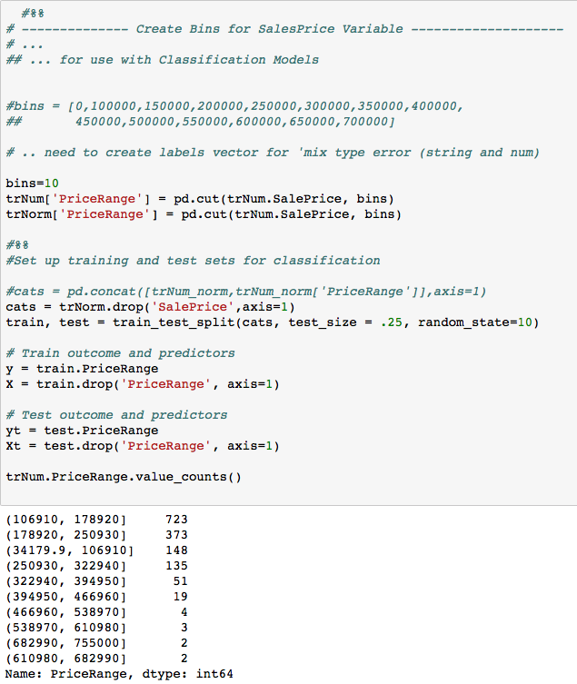
Model Training - Random Forest Classifier
Finally, we perform binning using pandas native cut() function, and then run our data through a Random Forest classifier. The results are actually a healthier expected out-of-sample error through cross-validation albeit with a lower initial accuracy. However, as we are attempting to predict a continuous outcome, the pursuit of classification in this case may not be a fruitful endeavor.

Slide 16
Conclusions and remarks for future research
Utilizing Spectral Clustering for feature derivation organically improves our model accuracy when Gradient Boosting with 250 estimators.
Dimensionality reduction with PCA does not yield us significantly greater accuracy although there is marginal improvement, we should turn to advanced feature engineering.
It may prove worthwhile to try modeling with dummy variables while being aware of overfitting and test set distinction.
Given the high multicollinearity across features concerned with a top-level property attribute, it would be of interest to derive features to represent core property attributes (Bsmnt, Garage) rather than relying on multiple measures for each one. Addressing outliers may prove the most beneficial for improvement in accuracy and breaking through the ~90% resistance level.
The most robust potential may be through deriving or otherwise acquiring more dimensionality on features regarding the transaction itself.
It would also be of interest to explore a combination of predictor models (GBR, Lasso, Ridge, SGDR, ElasticNet) for greater accuracy rather than relying on one model alone.

